Slide 1
Public transport access detection
Comănac Dragoș-Mihail

Slide 2
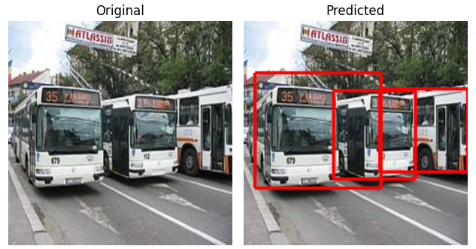
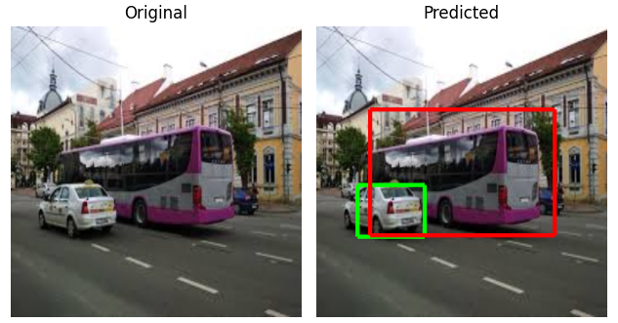
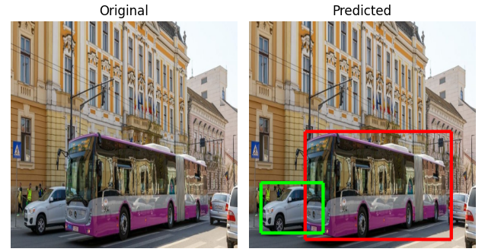
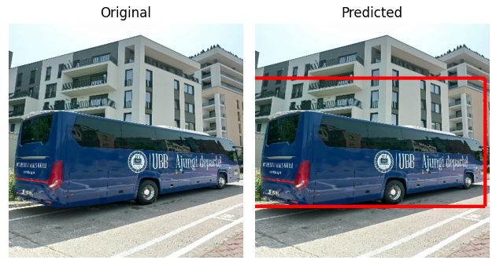
Motivation
*images from Cluj-Napoca

Slide 3
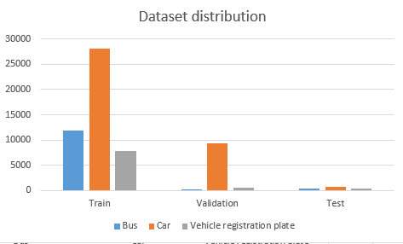
Open Images V4
* Images were collected using https://github.com/EscVM/OIDv4_ToolKit

Slide 4
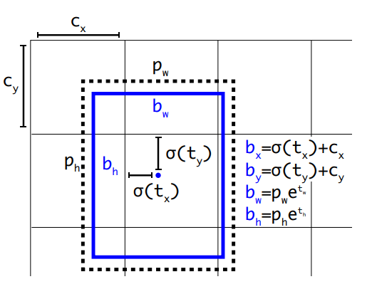
Source: YoloV2 https://arxiv.org/pdf/1612.08242v1.pdf

Slide 5
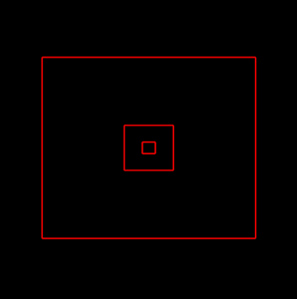
Anchors

Slide 6
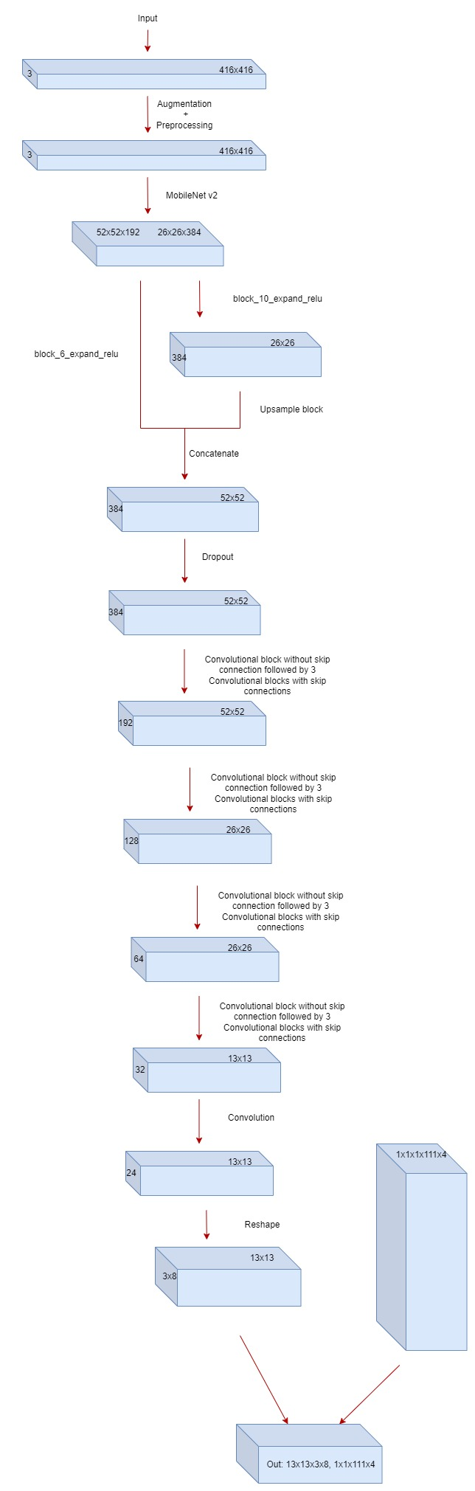

Slide 7
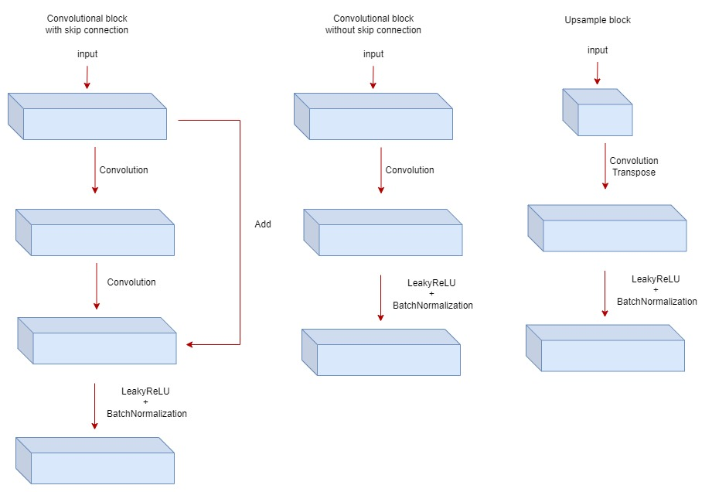

Slide 8
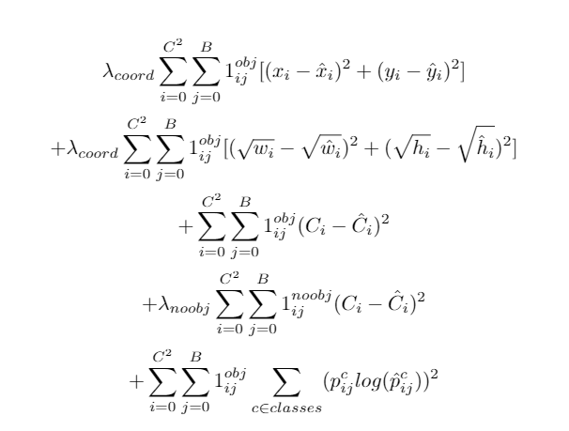
Loss

Slide 9
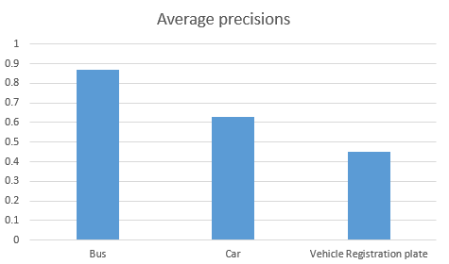
Mean average precision: 0.6522 ~4FPS on GPU

Slide 10
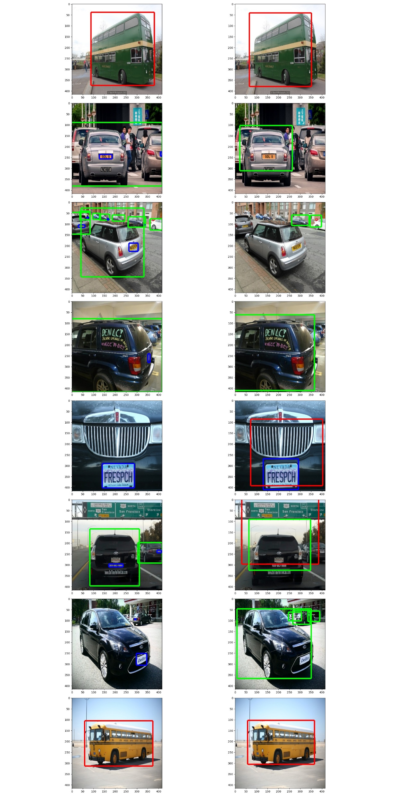
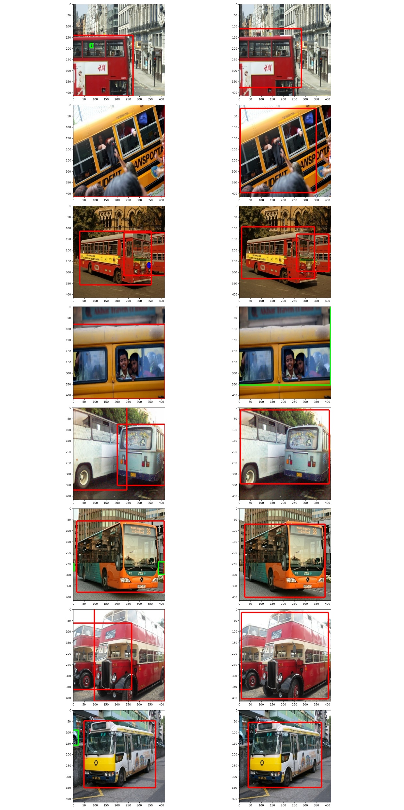
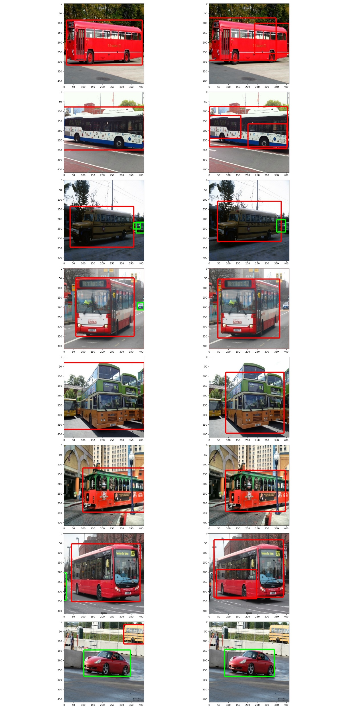

Slide 11
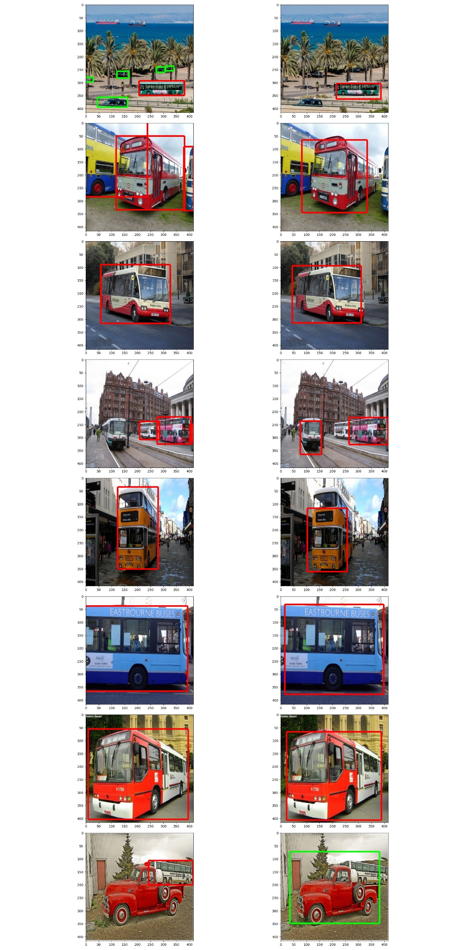
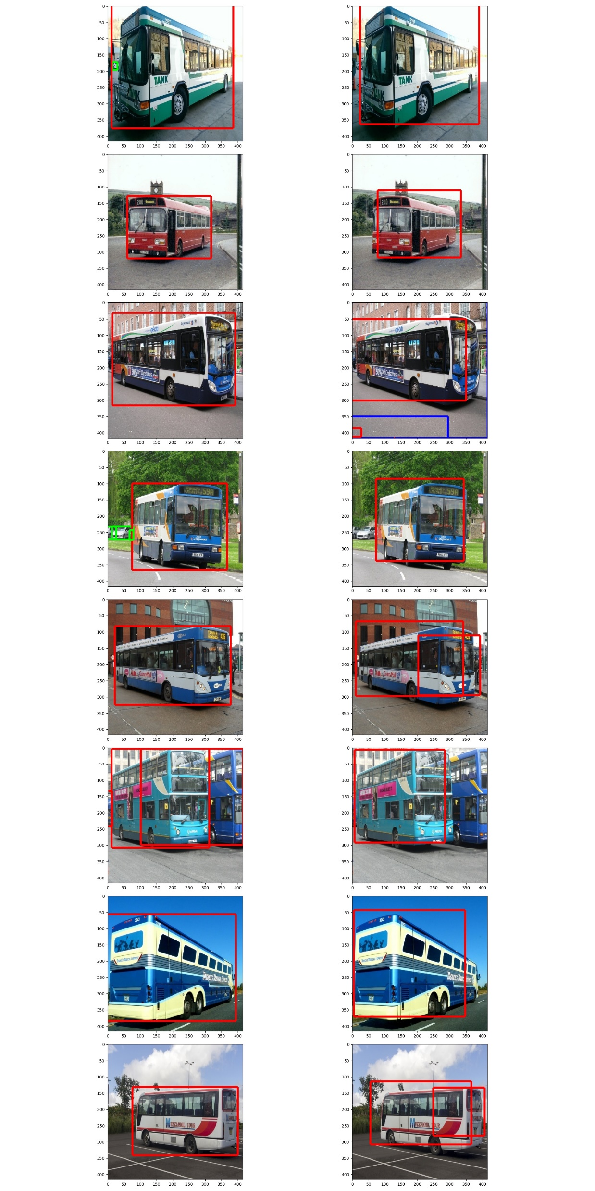
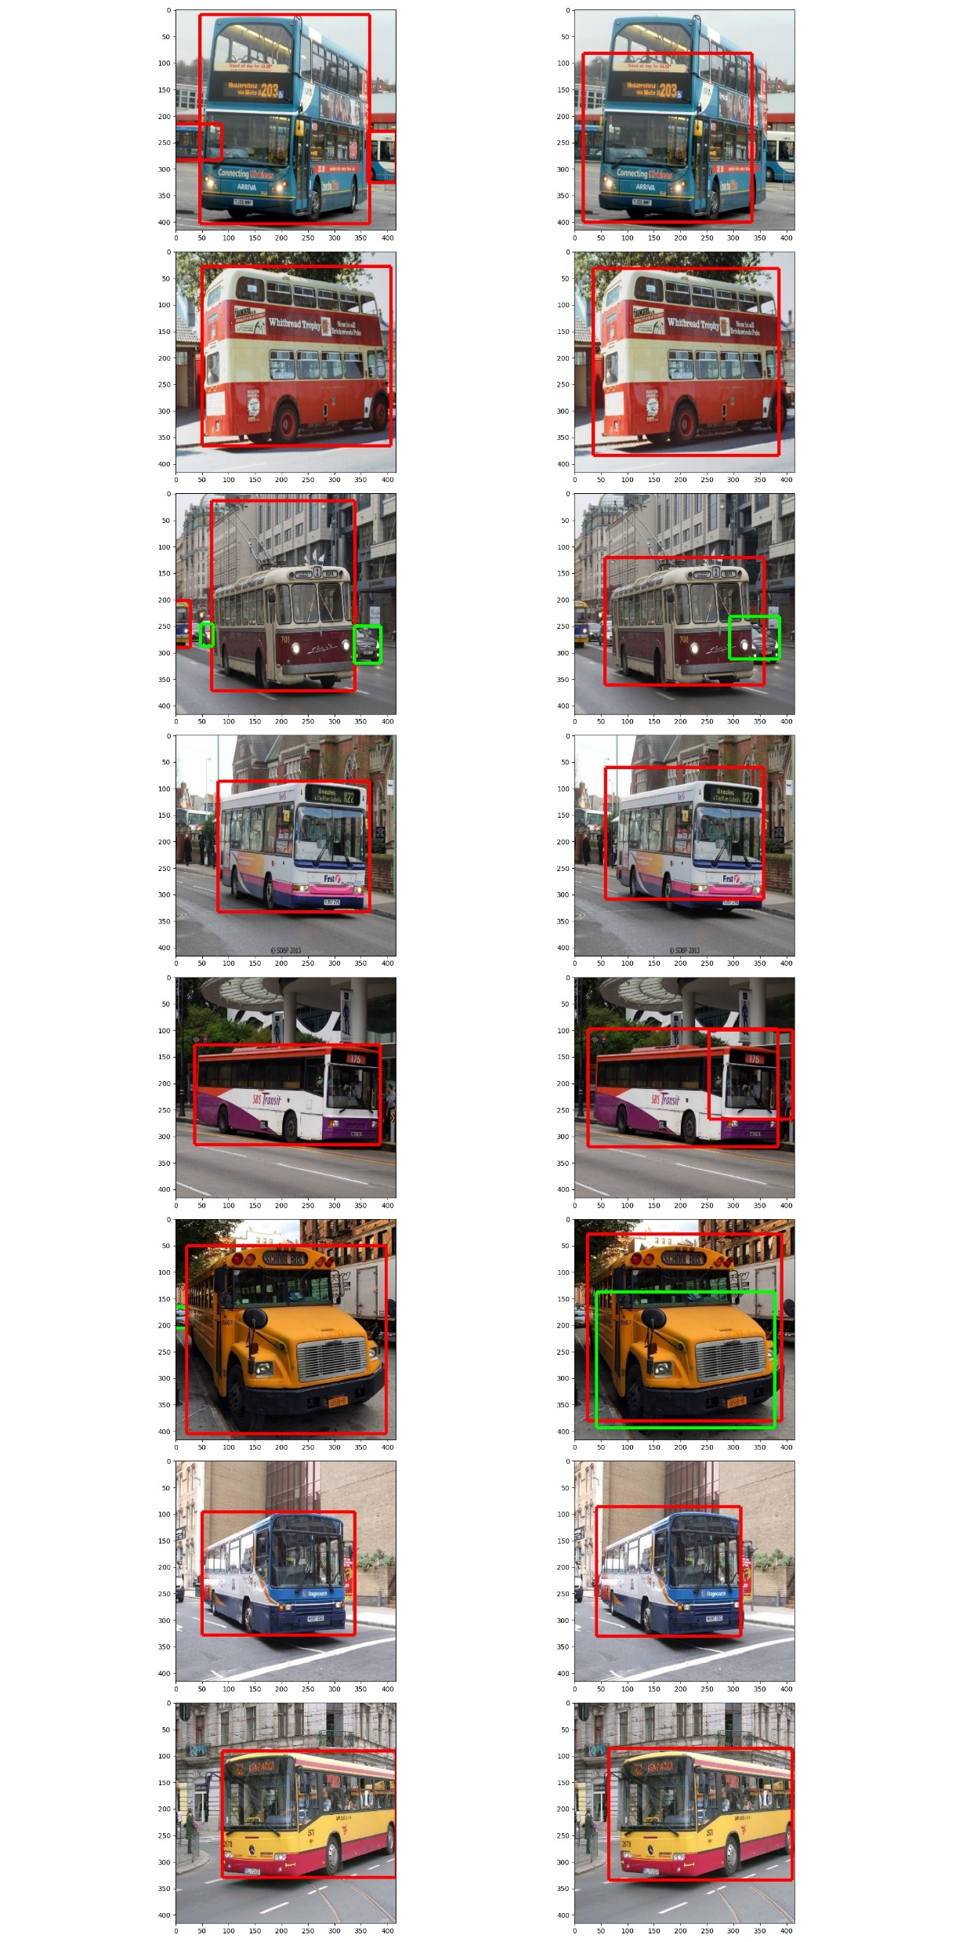

Slide 12
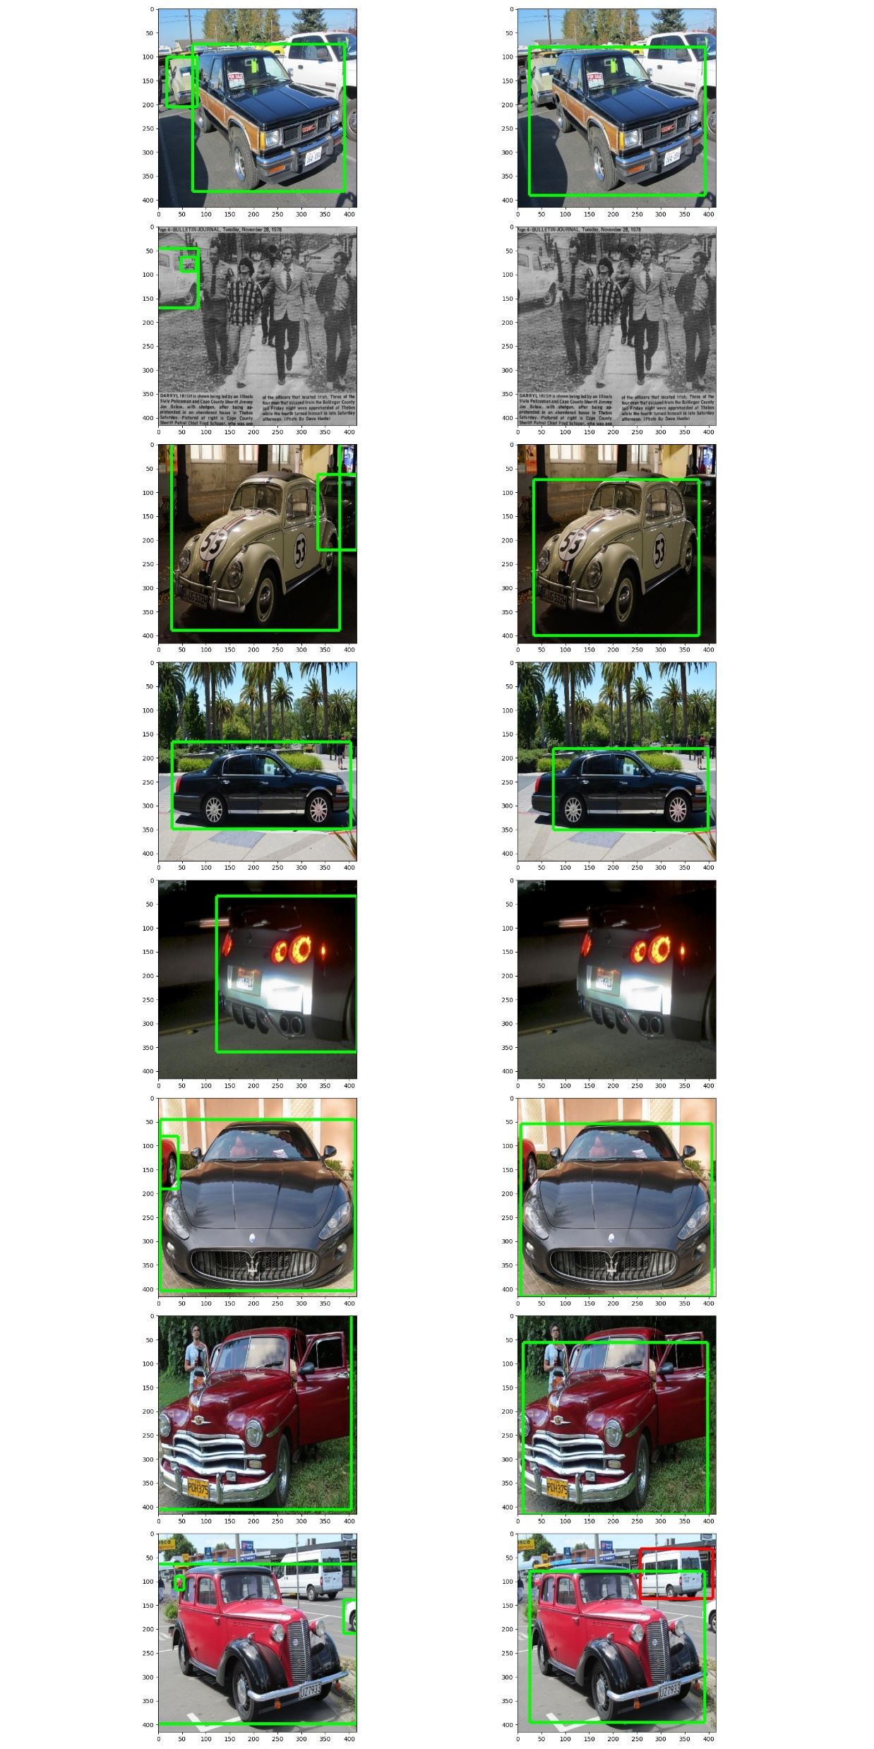
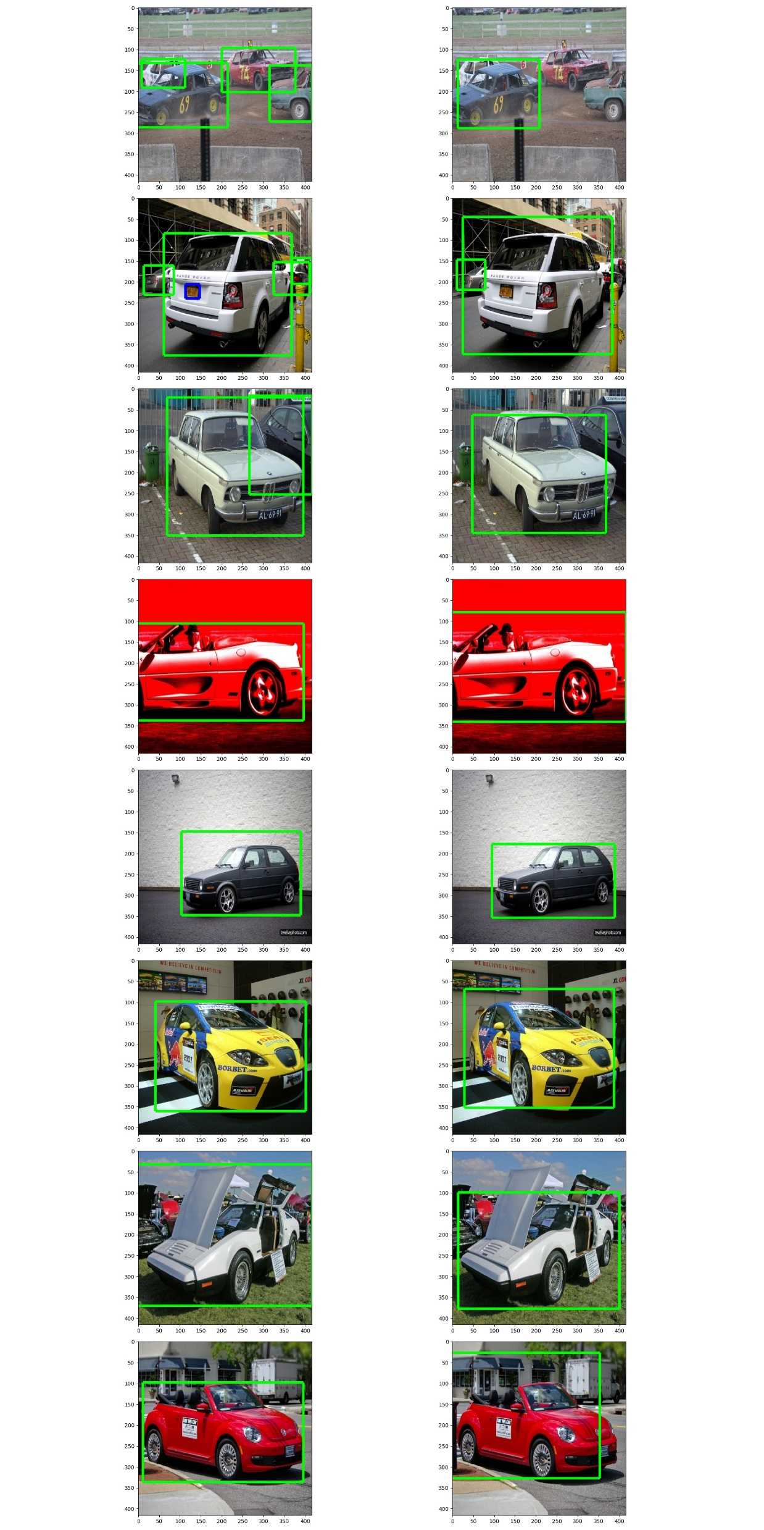
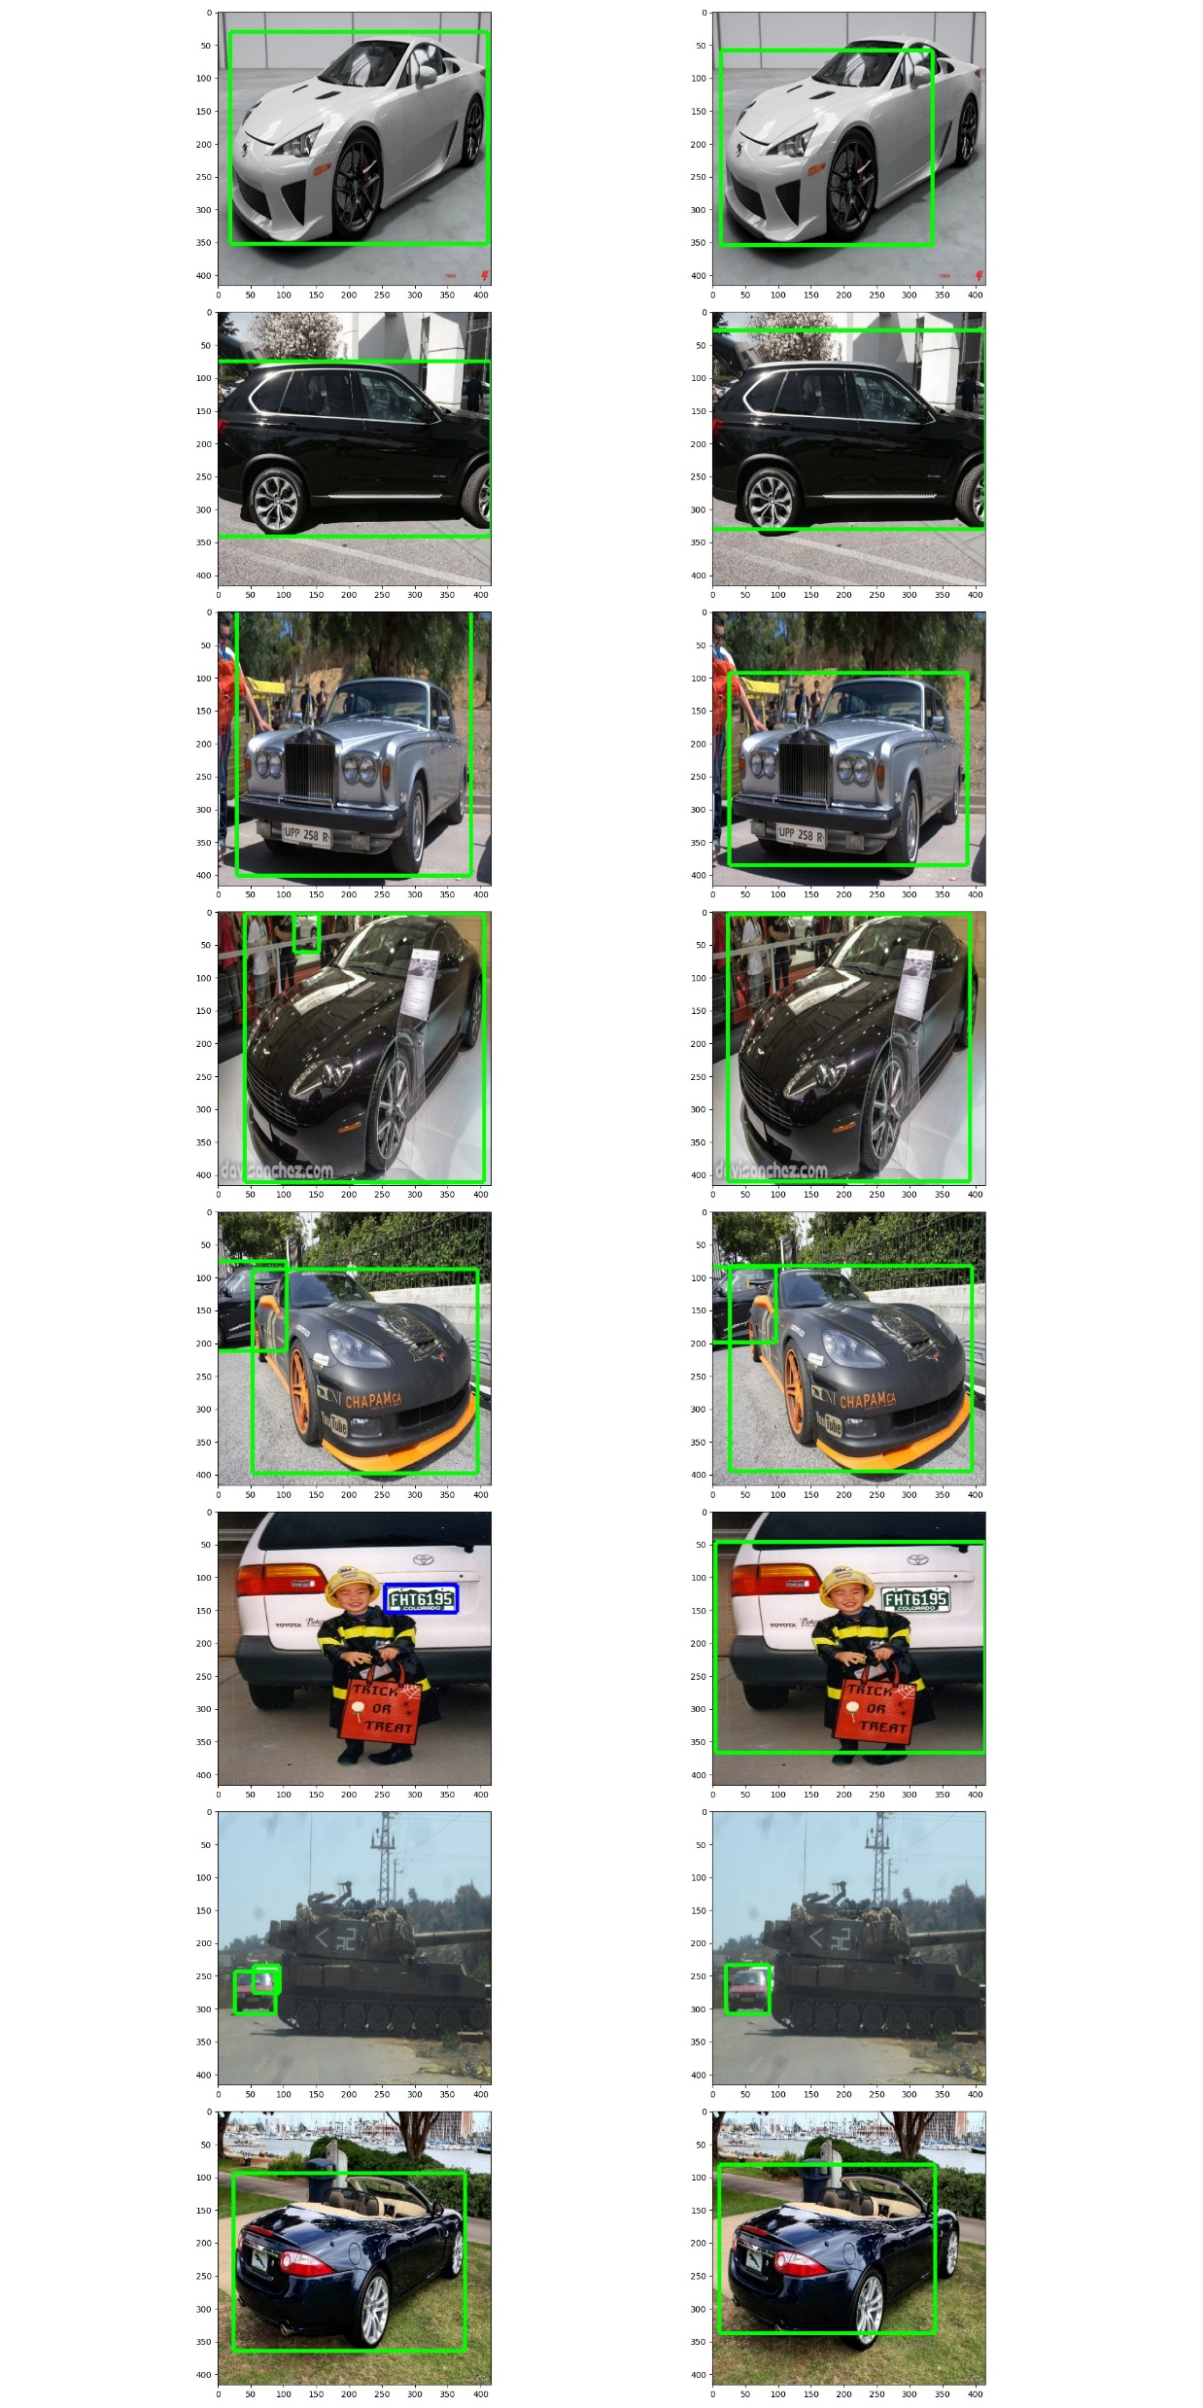

Slide 13
Conclusions
Future work
Non-maximum suppression can be optimized
Dataset annotations quality can be improved
Experiment with other data augmentation techniques
Experiment with other loss functions
Mobile integration
State of the art: 65 FPS YOLOv4

